Slide 1
Predicting Healthcare Coverage
Anand Raman

Slide 2
Dataset
Current Population Survey Annual Social and Economic Supplement
Part 1 Household file: 95000 observations
Interview: 67000 observations
Non-interview
Part 2 Family File
Part 3 Person File

Slide 3
Methods
Dataset: The household file of the 2017 data for the Current Population Survey Annual Social and Economic Supplement
EDA: 30% of data
Training Set: 85% of data
Testing Set: 15% of data

Slide 4
Outcome Variable
Current Coverage:
now_hcov: Current healthcare status of houshold
3 Levels: Everyone, Some People, No One
Recoded to two levels
Everyone, or some/none

Slide 5
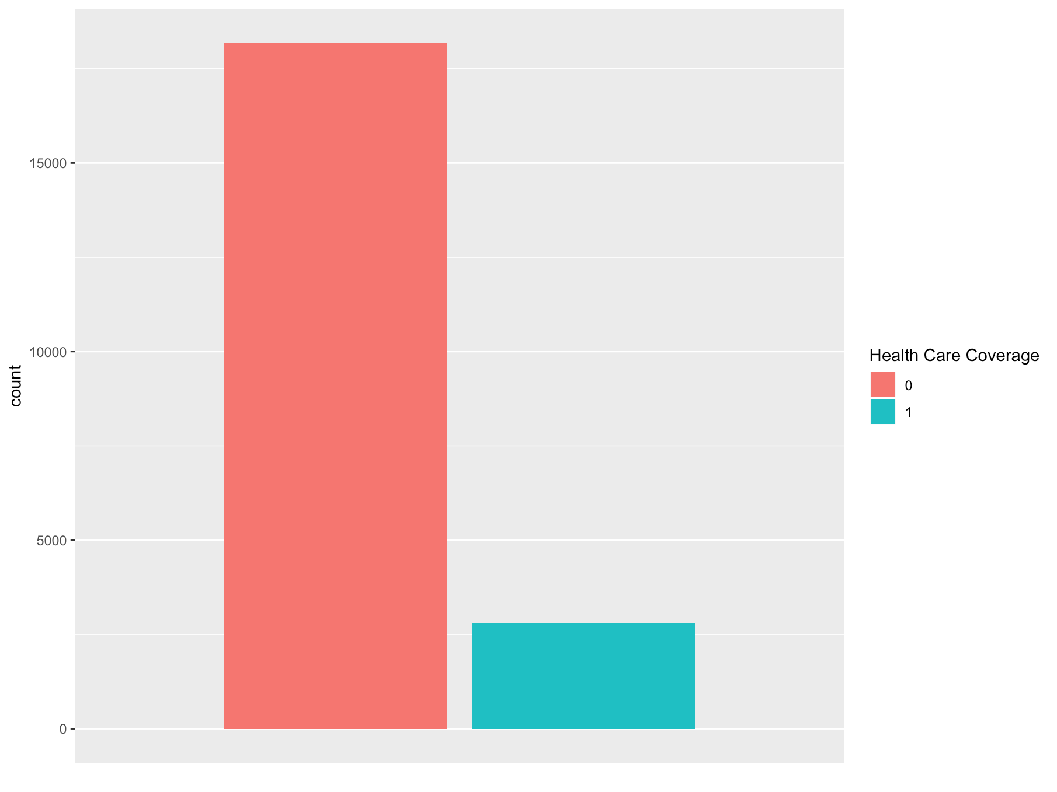
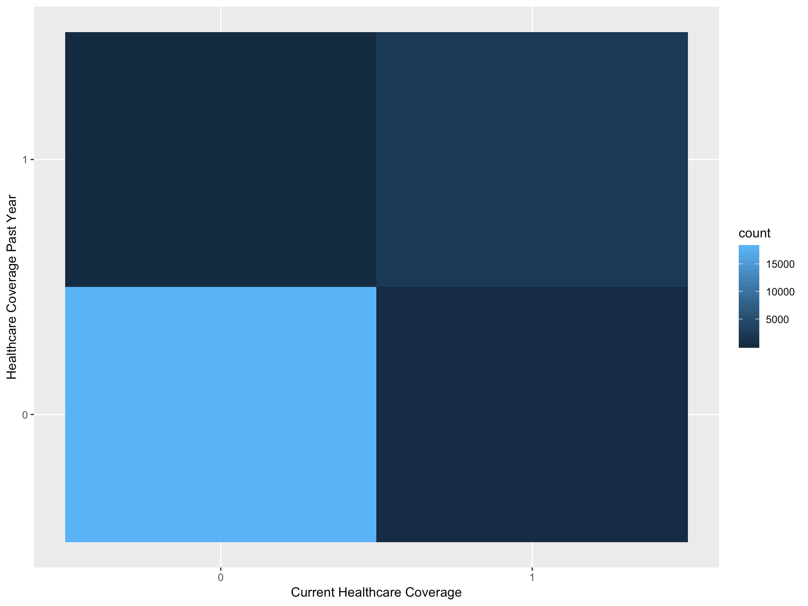
Current Healthcare Coverage
Relatively low percentage (~13%) of households who are not covered at all or only have some people covered

Slide 6
Predictors And Response: Troubleshooting
Redundant Metrics:
Household Income Recoded and Real Value of Household Income etc
Indicator Variables
Top coding
Allocation Flags
Doing my best not to cheat:
Multiple stand-ins for current healthcare coverage
Current Medicare coverage
Current private healthcare coverage

Slide 7
Model Building
Null Classifier Test Error Rate: 0.134
Ridge Regression:
Test Error Rate: 0.134
Lasso Regression:
Test Error Rate: 0.133
Forwards and backwards selection:
Test Error Rate: 0.133
8 variables included
Evaluation:
Model performance as of now is quite poor, only beating the null by about 0.1%.
Multicollinearity and correlation
Battling the Null Classifier with Logistic Regression

Slide 8
Next Steps
Finding a Better Model:
Classification Tree
Lots of binary variables
LDA or QDA
Eliminates a lot of questions asked to only subsets of the households
KNN
Might be difficult to implement with so many 0,1 variables
Clean Up Predictors
Get rid of predictors that overlap too closely with others
Review the list of predictors and eliminate missed allocation flags etc.

